Slide 1
BBSW 2021
Extreme Consulting
Jeetu Ganju
Ganju Clinical Trials, LLC jganju@yahoo.com

Slide 2
Part 1: Why I made the switch
Part 2: Why ‘extreme’ consulting
Part 3: A suggestion for re-organizing the
workflow within clinical development

Slide 3
The Audacity of Hope Slope
CEO: continuous learning, risk taking
Biometrics
Learning
Graduate school
Pharma career

Slide 4
A Question
Pivotal trial: primary is hard endpoint
Power = 40%
Prior Phase 2 was positive on soft endpoint
Is the pivotal a go?

Slide 5
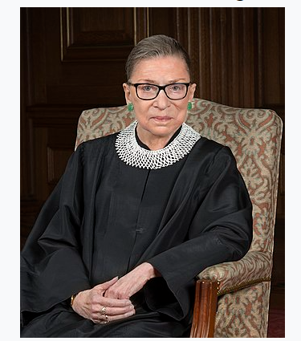
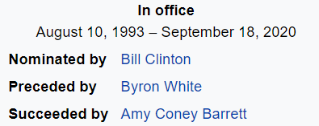
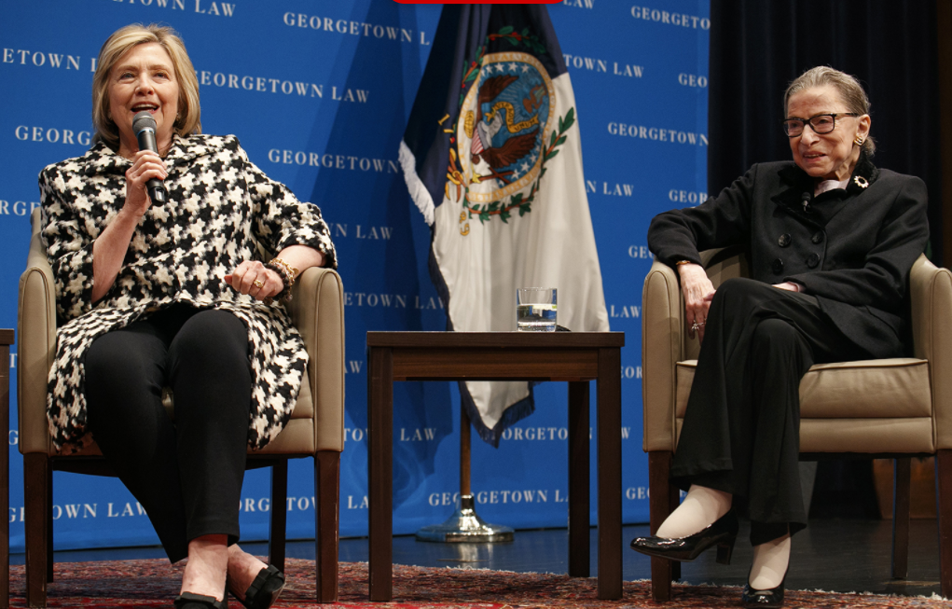
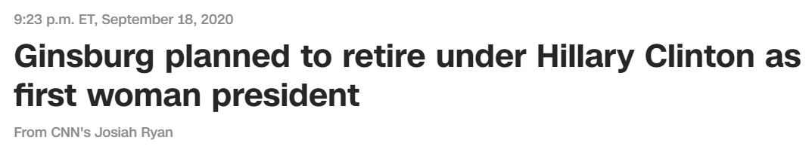
The Year Now is 2014
https://en.wikipedia.org/wiki/Ruth_Bader_Ginsburg
https://edition.cnn.com/us/live-news/ruth-bader-ginsburg-death-live-updates/h_9f9a71f529b2c5e90e864c624eecbd15

Slide 6
Your Growth Areas
What gaps would you like to fill?
Bayesian methods, programming (e.g., Python), false discovery rate
Biology, PK/PD modeling, business development, fund raising
Design > Endpoint > Analysis, or
Endpoint > Design > Analysis

Slide 7
Swim Lanes
Biometrics
No Man’s Land
No Person’s Land
Many Persons Land
Label extension studies
Accel. or traditional approval?
File on strong Ph2 data?
Earlier EOP2 meeting?
Target product profile
Ph3 trial endpoint & duration
Narrow vs broad label
PRO development to support surrogate?
Clin Science
Clin Pharm
Regulatory
Clin Ops
Med Affairs
Commercial
Safety, PV
Proj Mgmt

Slide 8
Part 2: Why ‘extreme’ consulting
+ tradeoffs
+ work experience

Slide 9
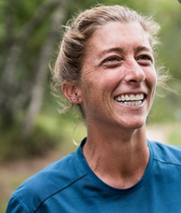
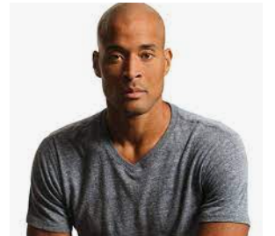
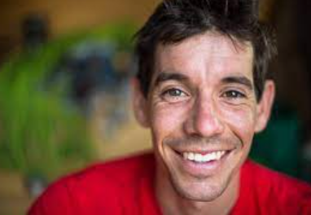
Do You Recognize These People?
Courtney Dauwalter
salomon.com
David Goggins
ahigherbranch.com
Alex Honnold
climbing.com

Slide 10
New Principles
FTE
Set by default
Team player
Manager
Technical
Consulting
Write your own
Independent work
Not looking to be
Liked
Respected
The present matters, past accomplishments don’t
Pre-requisite: financial stability

Slide 11
New Habits
Solve the problem. Swim lanes
Working independently Living in Montana
what it means for me: wearing noise cancelling headphones
The priest and the independent statistician
Learn, take risks

Slide 12
Tradeoffs
FTE
e$
Title
- Team feedback
Work structure in place
Staffing model: less competitive
Independent
$+$+$+…
Absence of title
No feedback. Blind spots
Get to experiment on myself
More competitive

Slide 13
Examples of How Time is Spent
Develop the Clinical Development Plan
Similar topics with Asset Acquisition team
- path to registration, endpoint selection, Ph3 N, speed
(very little touching of data, which is OK)
Re-analysis of trial with weak results
(way too much touching of data, which is not OK)
CRO interaction
experience

Slide 14
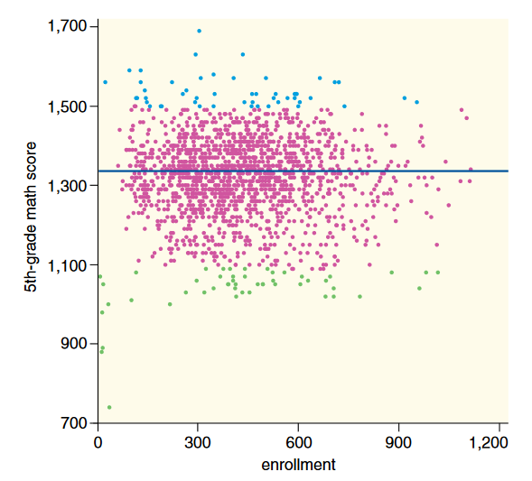
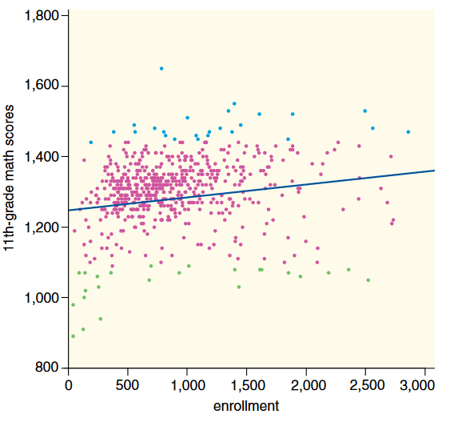
Example: Test Scores and School Size
Wainer H The most dangerous equation
Ignorance of how sample size affects variation has created havoc for nearly a
millennium. American Scientist, 2007.

Slide 15
Large and Small Pharma
Different approaches to trial design, analysis and interpretation
Large pharma: process based
Small pharma: personality based
Phase 2 audience: different for large and small pharma
Small pharma experience when Ph2 positive and when not

Slide 16
Part 3: A suggestion for re-organizing the
work-flow within clinical development

Slide 17
Swim Lanes
Biometrics
Many Persons Land
Label extension studies
Accel. or traditional approval?
File on strong Ph2 data?
Earlier EOP2 meeting?
Target product profile
Ph3 trial endpoint & duration
Narrow vs broad label
PRO development to support surrogate?
Clin Science
Clin Pharm
Regulatory
Clin Ops
Med Affairs
Commercial
Safety, PV
Proj Mgmt
So many interesting problems to solve between
functional boundaries!

Slide 18
The Promised Land
What ifs
What if, for complex issues, we blurred the functional lines in the sand?
What if we realized that subject matter experts will develop insights on topics that transcend conventional functional responsibilities?
What if we cannot identify the function of the person making innovative contributions on complex drug development topics?
(A bit like how one may not be able to tell the background of DMC members for some
discussions)

Slide 19

Teamwork, Workflow
Project manager is team lead
Does not serve as subject matter expert.
Knows where lines in the sand are not drawn
Has responsibility for adjudicating
competing ideas
Reward-based system for serious ideas
Crucial: careful, regular, feedback on
project manager’s role. Iterative process
getsling.com

Slide 20

Santa Fe Institute
“SFI has been internationally recognized as the “formal birthplace of interdisciplinary study of complex systems”…”
A recognition that the “academic landscape had become so dominated by disciplinary stovepiping…that many big questions…transcending disciplines…were being ignored.”
“…many of the most challenging, exciting and profound questions facing science and society lie at the boundaries between traditional disciplines”

